Slide 2
Subject
Chloroplast genome comparison of Sesamum and Cerathoteca sister species sheds light on phylogenetic relationships and adaptive evolution

Slide 3
Research Objectives
Generate the first assembly and annotation of four Sesamum species (S. alatum, S. angolense, S. pedaloides and S. radiatum) and related species (Ceratotheca triloba and C. sesamoides)
Identify high-divergence hotspots
Infer the phylogenetic relationship among Sesamum and Ceratotheca species
Evaluate the nucleotide substitution rate variation among Sesamum species.

Slide 4
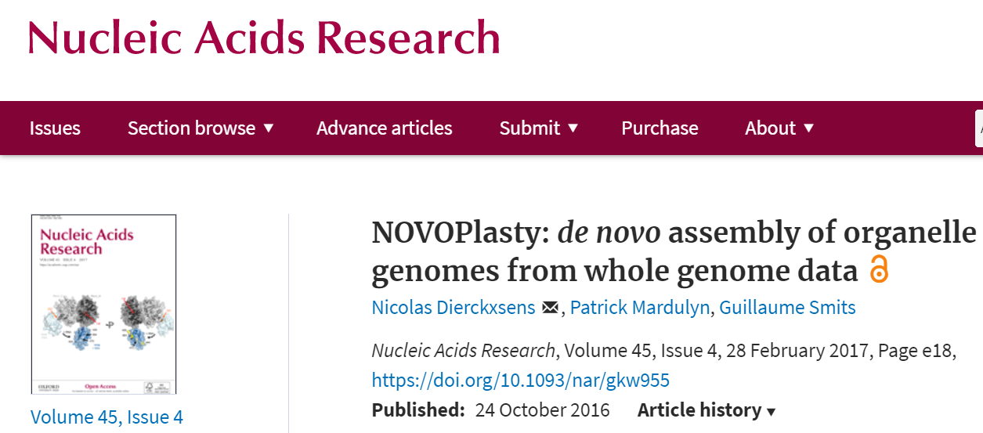
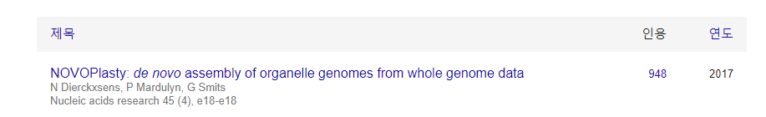
| Assembly | Algorithm Approach
Strategy 1: “Seed and extend” approach
Accessed the: November 25, 2020

Slide 5
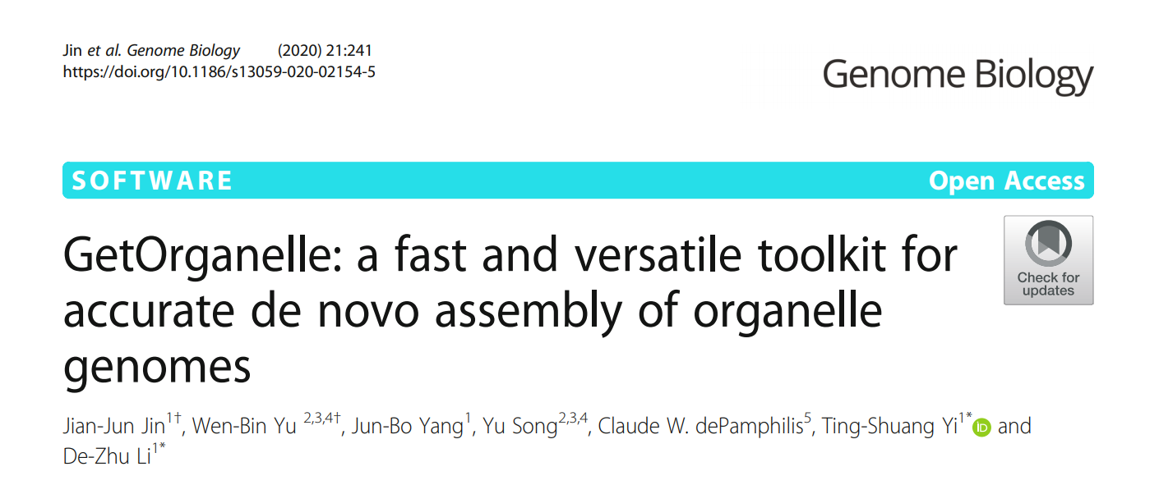
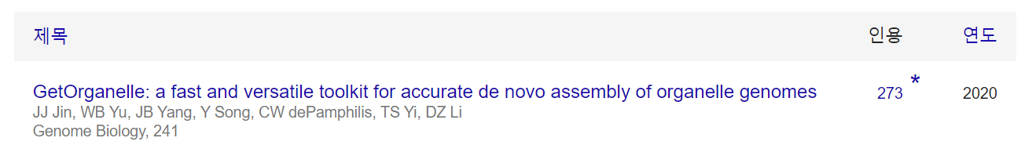
Assembly | Algorithm Approach
Strategy 2: “Baiting and iterative mapping” approach
Accessed the : November 25, 2020.

Slide 6
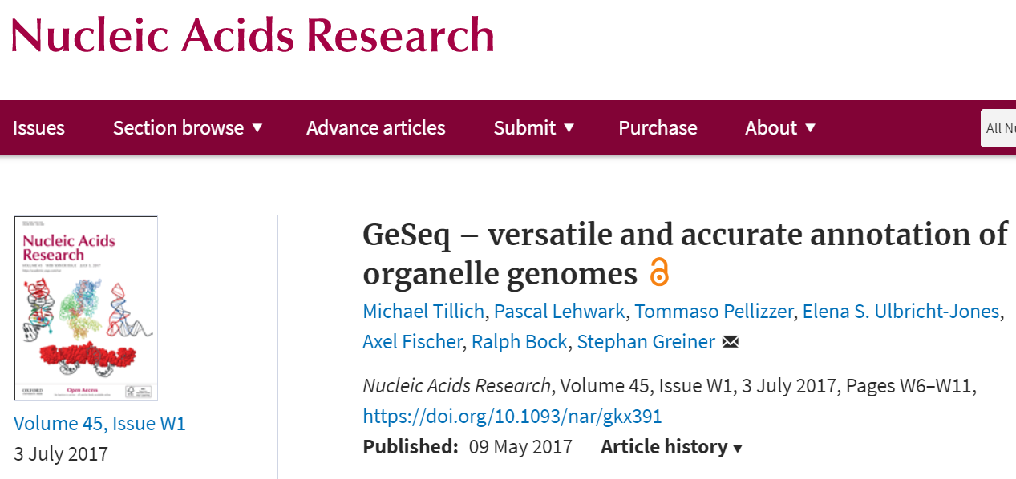
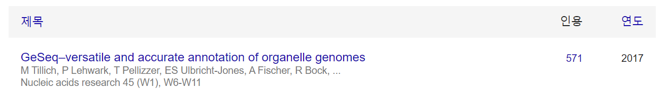
Assembly Annotation

Slide 7
Chloroplast genome features
 | Sesamum indicum | Sesamum alatum | Sesamum angolense | Sesamum pedaloides | Sesamum radiatum | Ceratotheca sesamoides | Ceratotheca triloba
Plastome length (bp) | 153338 | 153096 | 153089 | 153217 | 153285 | 153287 | 152863
GC content (%) | 38.2 | 38.27 | 38.25 | 38.26 | 38.27 | 38.27 | 38.29
IR length (bp) | 25142 | 25150 | 25157 | 25190 | 25131 | 25131 | 25096
IR GC content (%) | 43.39 | 43.42 | 43.37 | 43.39 | 43.39 | 43.39 | 43.41
LSC length (bp) | 85180 | 85004 | 85106 | 85118 | 85183 | 85185 | 84872
LSC GC content (%) | 36.34 | 36.38 | 36.38 | 36.41 | 36.43 | 36.43 | 36.44
SSC length (bp) | 17874 | 17792 | 17669 | 17719 | 17840 | 17840 | 17799
SSC GC content (%) | 32.47 | 32.75 | 32.67 | 32.59 | 32.63 | 32.64 | 32.62
CDS count | 80 | 80 | 80 | 80 | 80 | 80 | 80
tRNA count | 30 | 30 | 30 | 30 | 30 | 30 | 30
rRNA count | 4 | 4 | 4 | 4 | 4 | 4 | 4
Genes count | 114 | 114 | 114 | 114 | 114 | 114 | 114

Slide 8
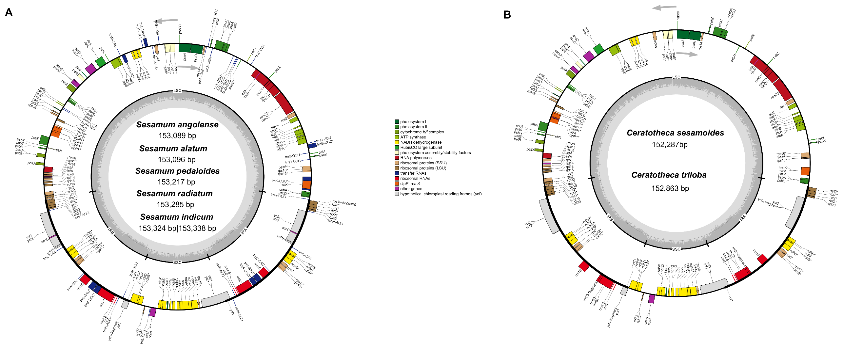
Annotation Map

Slide 9
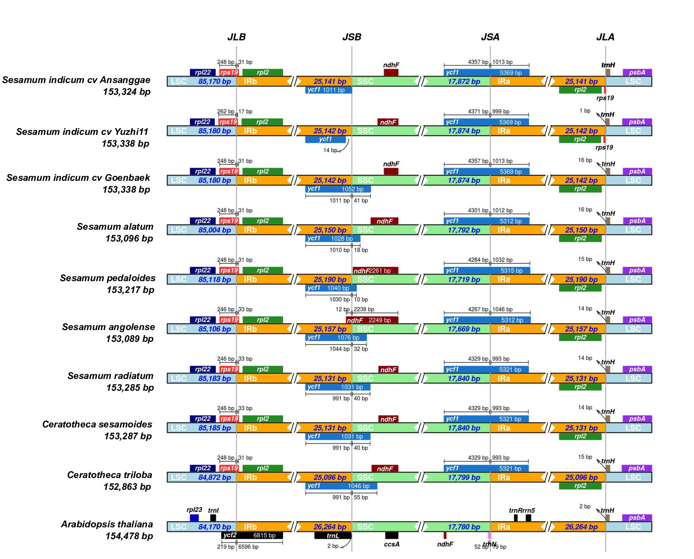
Junction comparison

Slide 10
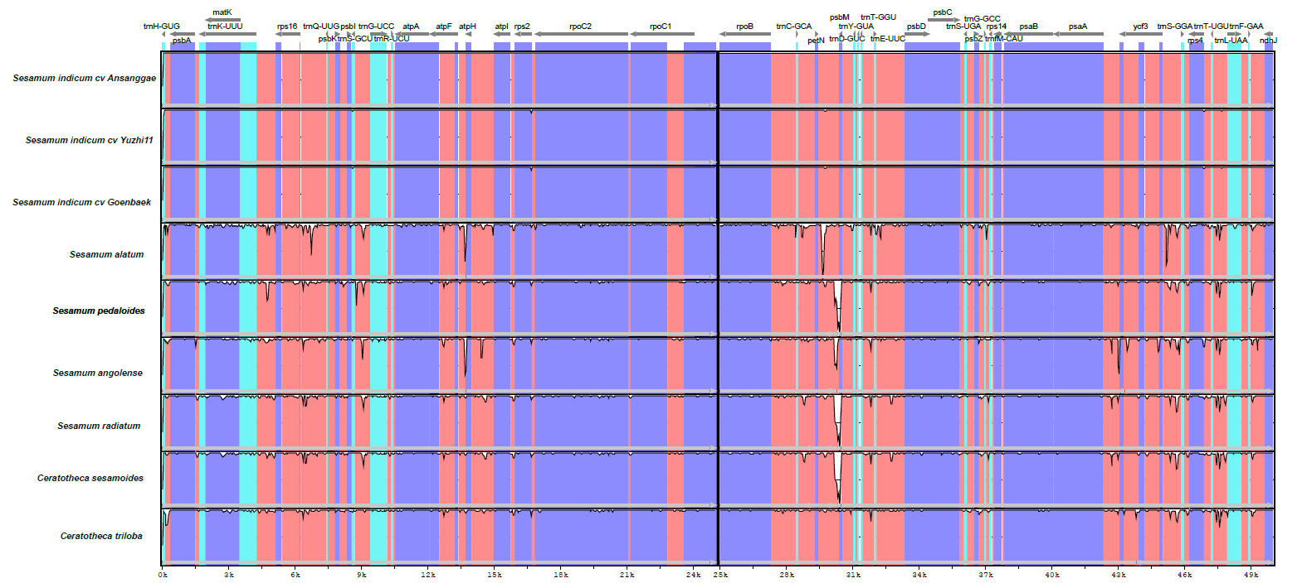
Comparative chloroplast analysis

Slide 11
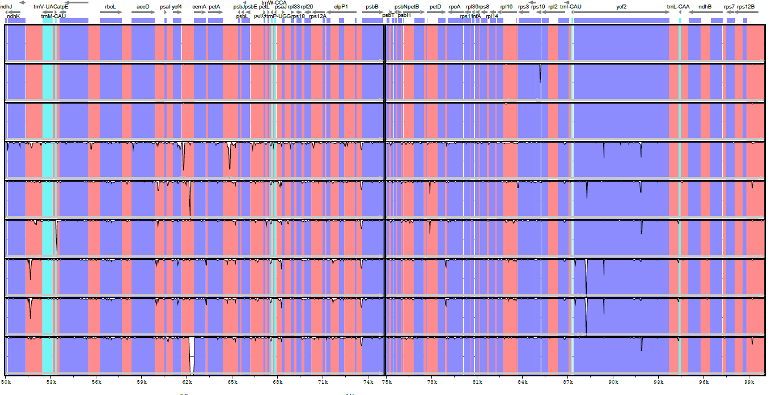
Comparative chloroplast analysis

Slide 12
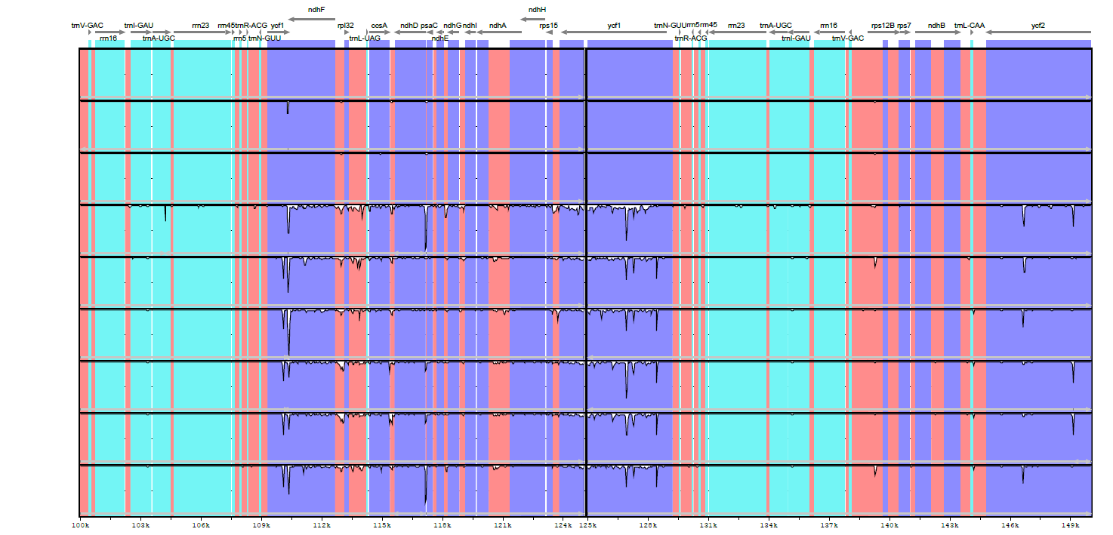
Comparative chloroplast analysis

Slide 13
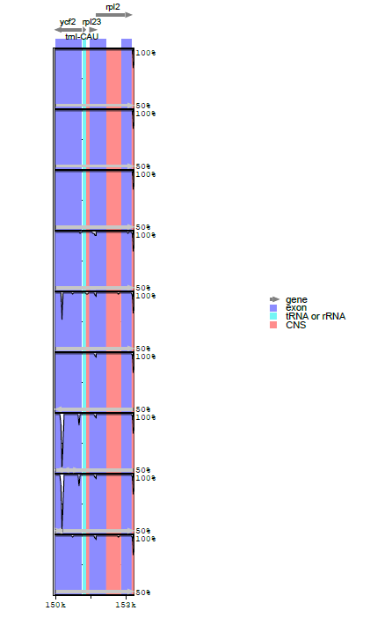
Comparative chloroplast analysis

Slide 14
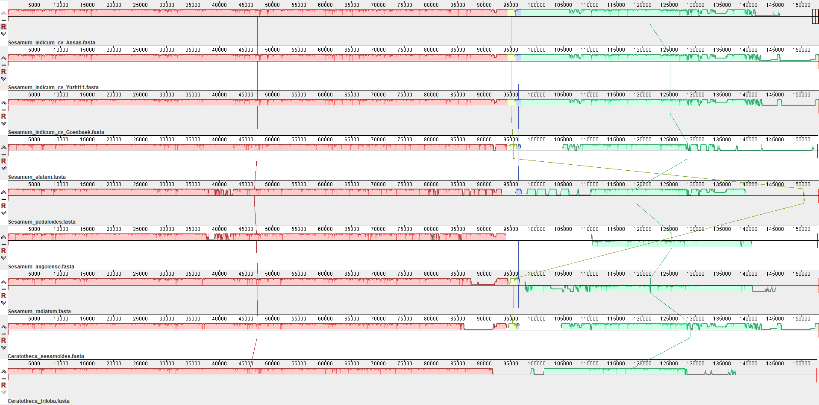
Comparative chloroplast analysis

Slide 15
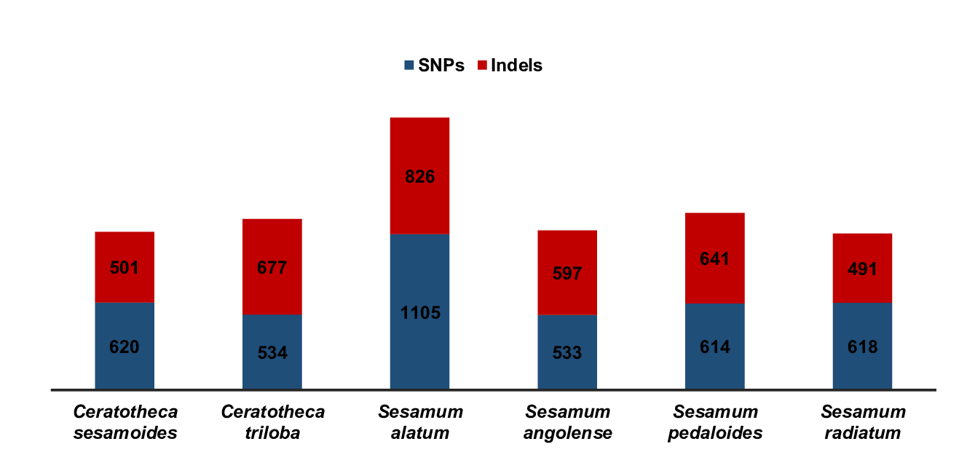
Sequence divergence
Sesamum indicum cv Goenbaek as reference

Slide 16
Repeats analysis

Slide 17
Repeats analysis

Slide 18
Repeats analysis

Slide 19
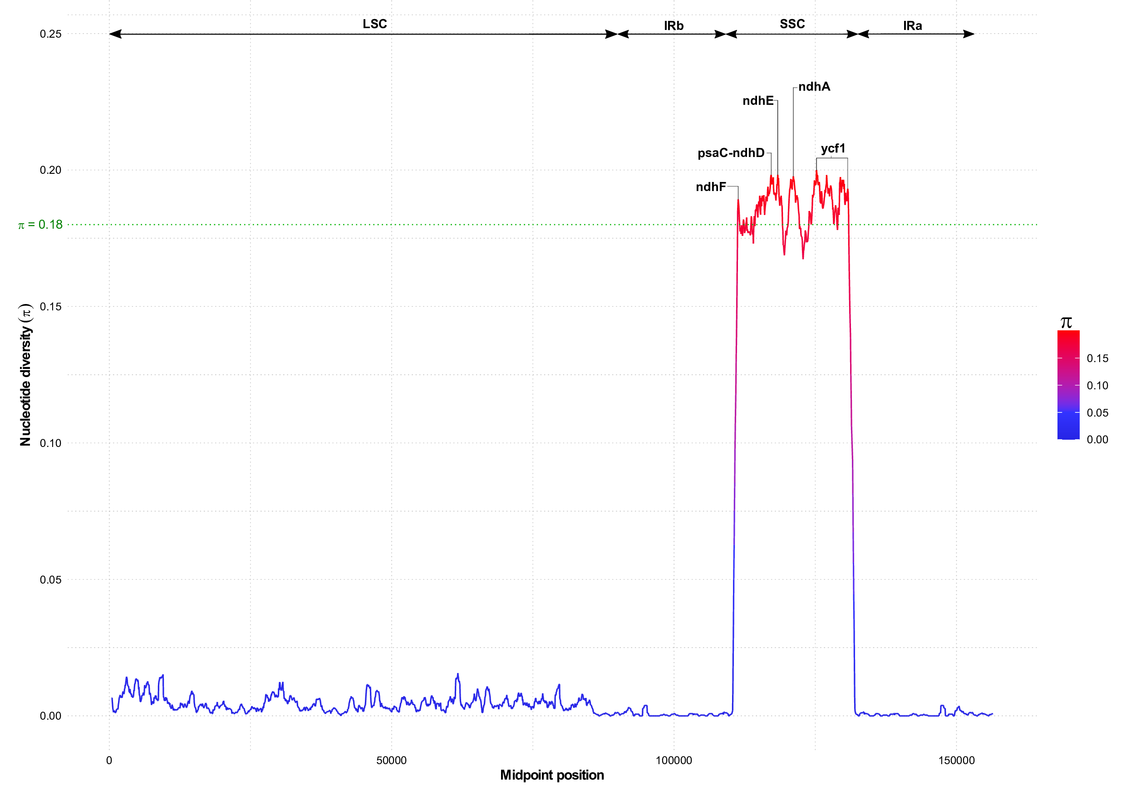
Sequence divergence | DNA Barcoding

Slide 20
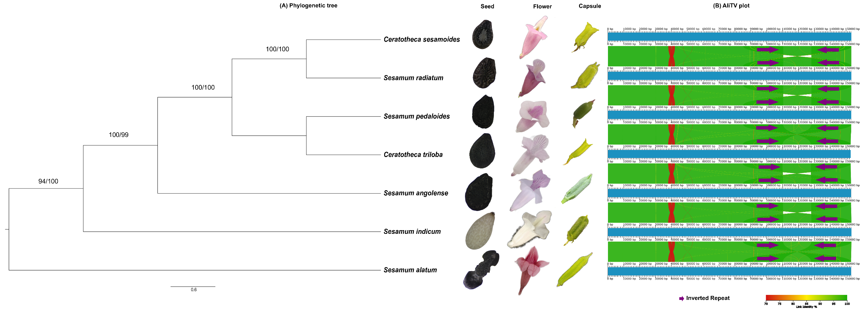
Phylogenetic analysis | ML & Bayesian

Slide 21
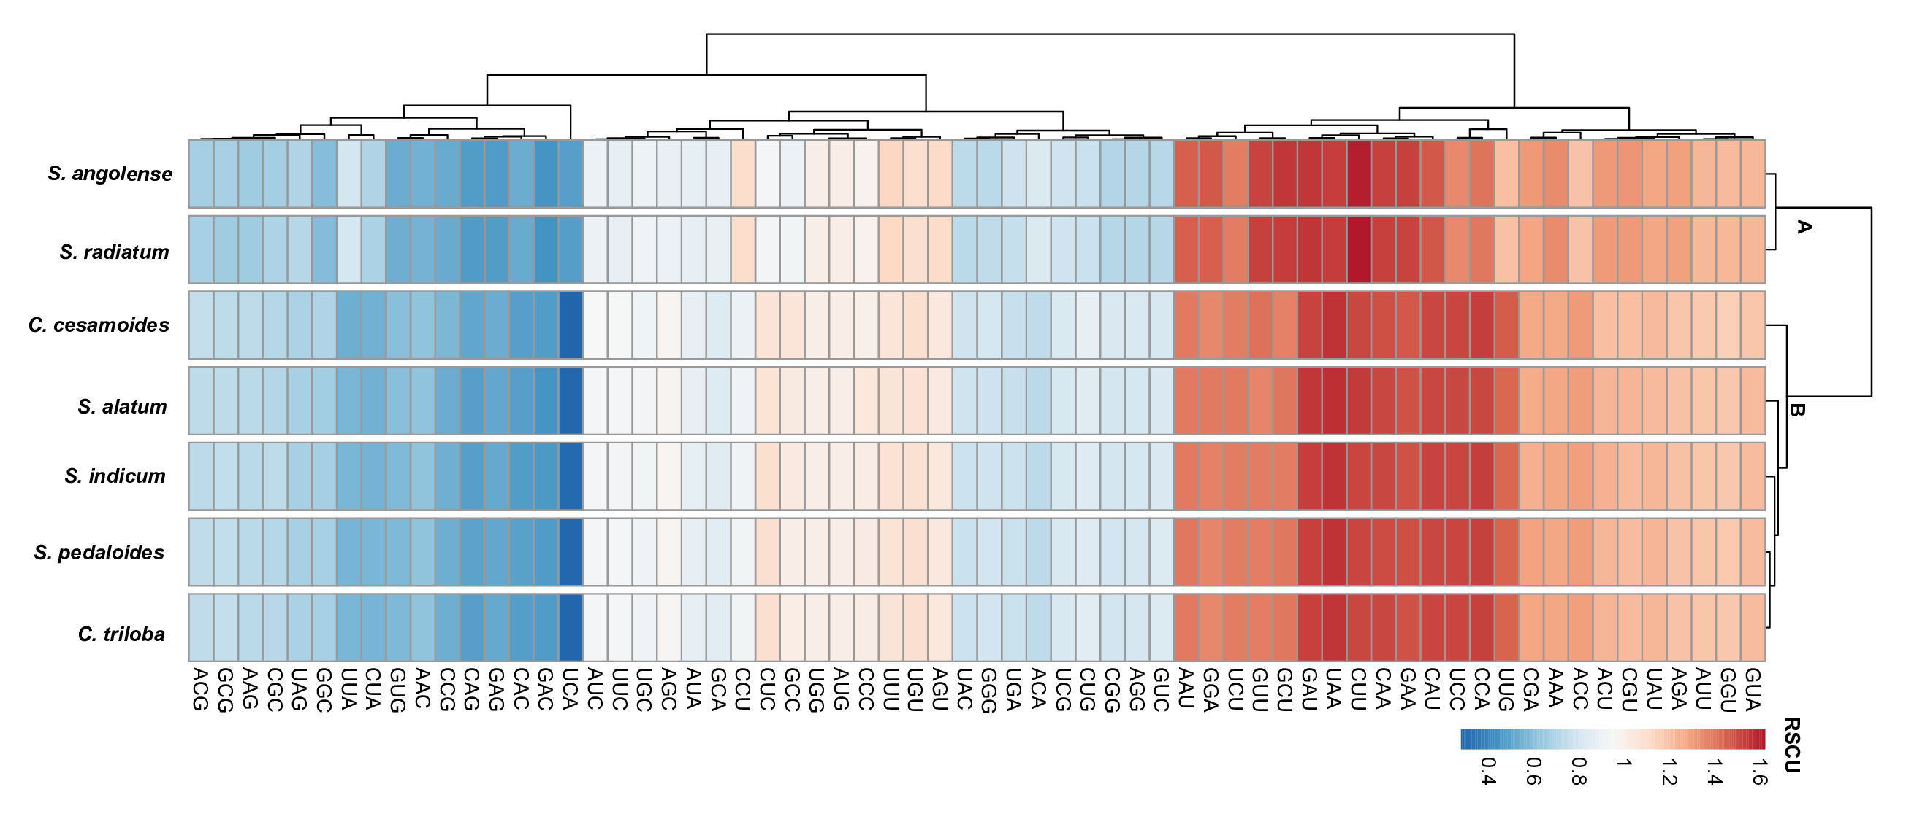
Relative Synonymous Codon Usage (RSCU)

Slide 22
Synonymous (Ks) and non-synonymous (Ka) substitution rate analysis
Gene | Ks | Ka | Ka/ks | Selection type
ndhA | 1.7637 | 3.4227 | 1.9406 | Darwinian
ndhF | 0.0106 | 0.014 | 1.3207 | Darwinian
ndhI | 1.3753 | 6.4091 | 4.660 | Darwinian
ycf4 | 0.0117 | 0.0404 | 3.452 | Darwinian
ycf1 | 0.9839 | 0.9866 | 1.002 | Neutral
rbcL | 0.0108 | 0.0071 | 0.657 | Purifying

Slide 23
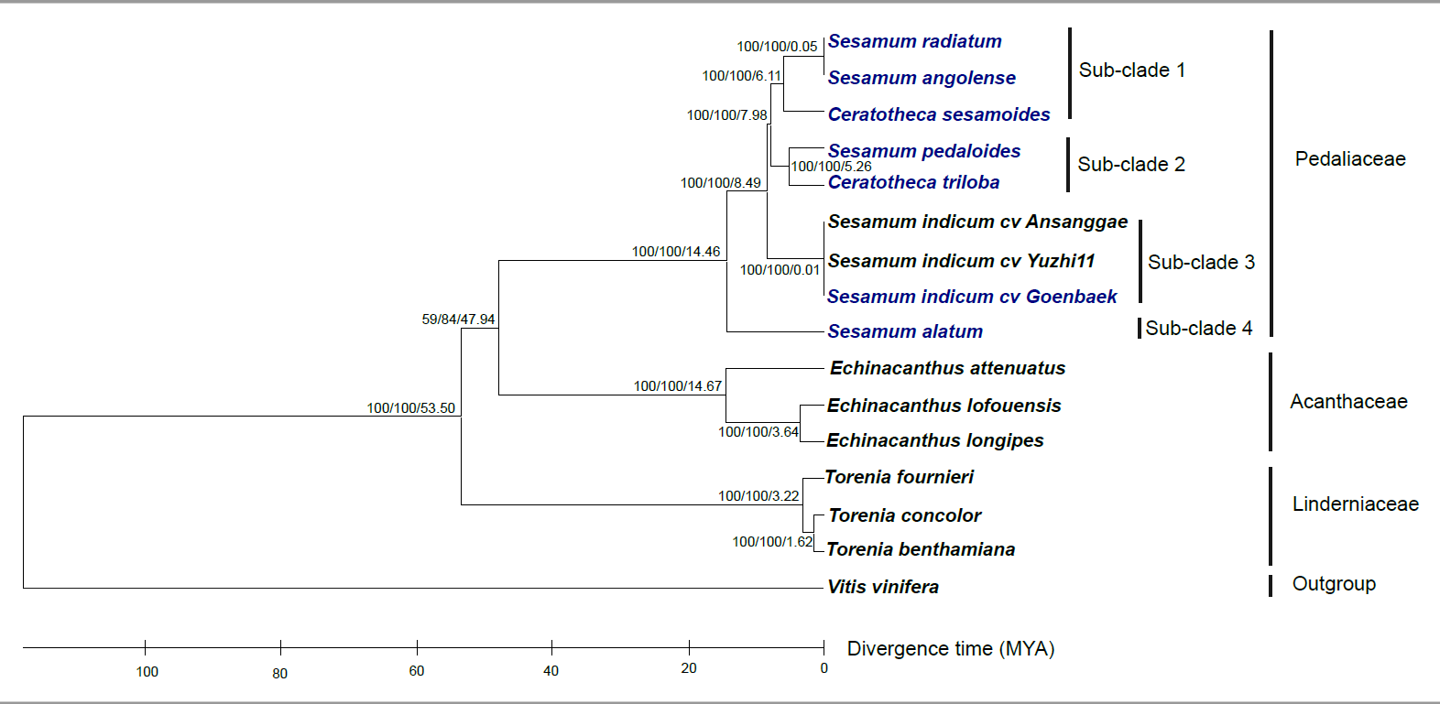
Divergence Time Estimation

Slide 24
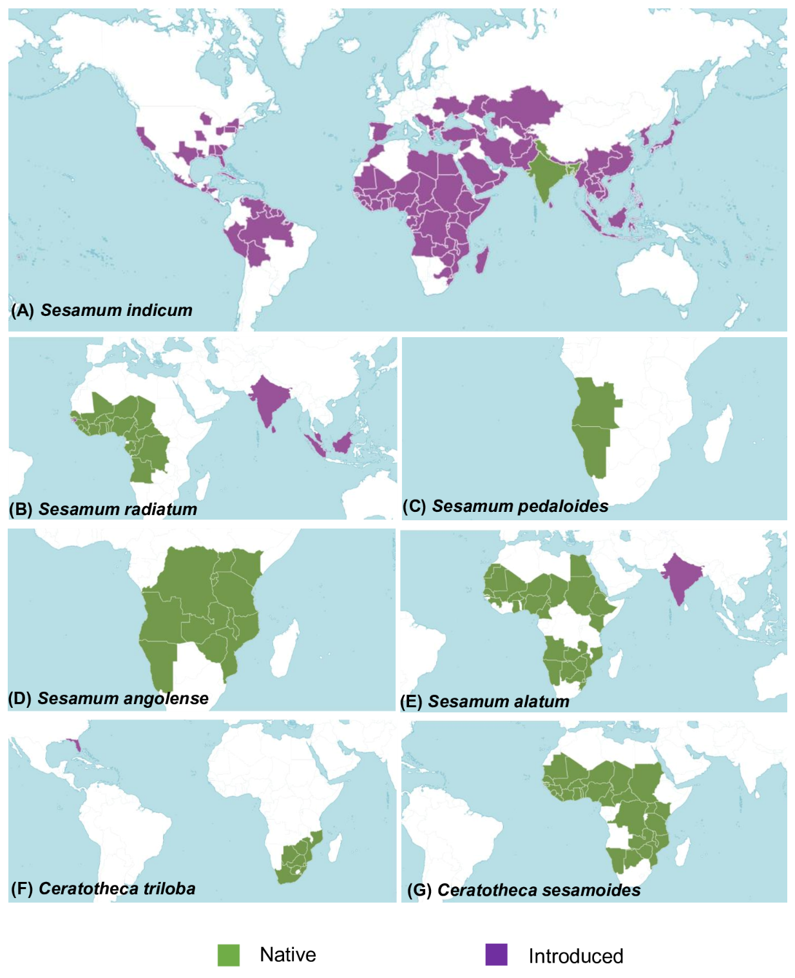
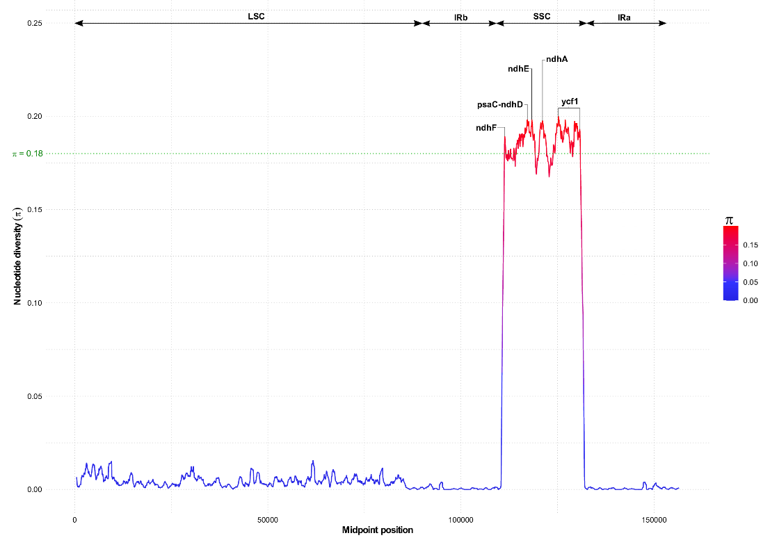
Take out

Slide 25
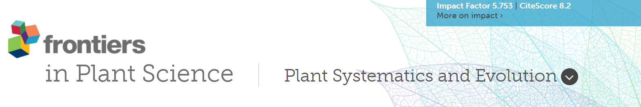
Target Journal and Publication Time Planning
Paper writing: 40%
Final version: December 2021/January 2022
Submission of chloroplast data to NCBI:……????.......

